Slide 1
Introduction to ML
Machine Learning through Application
Module 1 – Lesson 0

Slide 2
Today’s activities
Agenda and course overview
Discussing a business problem: Book pricing
What is ML?
ML key components
An example of a model that can solve the book price problem

Slide 3
Agenda and course overview

Slide 4
Course overview
Modules | Topics
What Is ML? | Key concepts, types of ML, ML lifecycle, application examples using Amazon SageMaker and AutoGluon
Core ML Concepts for Tabular Data | Exploratory data analysis (EDA), data engineering, optimization, regularization, regression and tree-based models, ensembling
Responsible ML | Introduction to fairness and bias mitigation, fair model formulation and metrics, bias mitigation throughout the ML lifecycle

Slide 5
Module 1 overview
Lesson | Topics
Lesson 0 | What is ML?, key components of ML, an example of using ML
Lesson 1 | Introduction to Jupyter notebooks and SageMaker
Lesson 2 | Data in ML, types of ML, aspects of successful ML problems
Lesson 3 | Common ML application domains, examples of ML applications
Lesson 4 | Introduction to the ML lifecycle, how models are evaluated
Lesson 5 | Introduction to AutoML and the AutoGluon library

Slide 6
Discussing a business problem: Book pricing

Slide 7
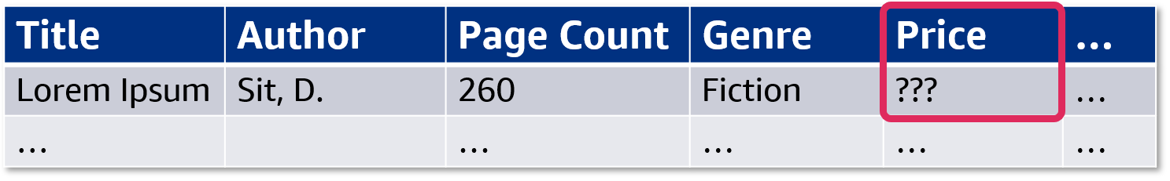
Problem: Authors don’t always know how much to charge
Need: An app that will suggest prices for books.
How could you create that?
Notes:
~Alt text: Table of data about books. See detailed description in notes.
~
Image description: Table with columns for title, author, page count, genre, and price. In the first row, the price feature is unknown and highlighted. End description.
Authors don’t always know how much to charge for their books.
Small publishers, self-publishers, and others don’t always have easy ways to know how to price their new books for sale. You decide to create an app that will suggest prices for books so that these authors can have a good reference point to use for their prices. How could you create an app to do that?

Slide 8
Let’s try a simple “if–then” rule
If book > 200 pages:
Suggest $30
Else, suggest $15
What could go wrong?
Notes:
If you take a traditional rules-based approach to solve this problem, you can start by making simple relationships. For example, if the book has more than 200 pages, then the bookstore should sell it for $30. Otherwise, the price could be $15.
What could go wrong with this approach? Discuss with your class what makes this solution not ideal.

Slide 9
Let’s try a simple “if–then” rule
If book > 200 pages:
Suggest $30
Else, suggest $15
What could go wrong?
A 1,000-page book for only $30?!
Hardcover or paperback?
Genre?
Notes:
Discuss with your class what makes this solution not ideal.
Of course, this solution is too simple. It fails to consider many factors that affect a book’s price. This solution could even introduce some unfavorable results, such as a 1,000-page book costing only $30, which is far below what large books are usually priced at and possibly lower than production costs.
This solution also doesn’t factor in other production costs, such as the cost to produce a hardcover book compared to a paperback book. Or genre, which can have a huge impact on the normal price that is expected. For example, nonfiction books are typically priced higher than fiction books.

Slide 10
What about more complex “if–then” rules?
If book ≥ 200 and < 400 pages:
Nonfiction, hardcover: $50
Nonfiction, paperback: $30
Fiction, hardcover: $20
Fiction, paperback: $10
If book < 200 pages:
Nonfiction, hardcover: $25
Nonfiction, paperback: $20
Fiction, hardcover: $15
Fiction, paperback: $8
Additional pricing rules are used if book ≥ 400 pages.
What problems does this present?
Notes:
Maybe you need more rules to account for more factors. You can have a solution with several if–then rules.
Discuss with the class: What problems does this solution present? Why would this not be ideal?

Slide 11
What about more complex “if–then” rules?
If book ≥ 200 and < 400 pages:
Nonfiction, hardcover: $50
Nonfiction, paperback: $30
Fiction, hardcover: $20
Fiction, paperback: $10
If book < 200 pages:
Nonfiction, hardcover: $25
Nonfiction, paperback: $20
Fiction, hardcover: $15
Fiction, paperback: $8
Additional pricing rules are used if book ≥ 400 pages.
What problems does this present?
Accurate to the real world?
Different fiction genres?
Different subjects in nonfiction?
Popular author compared to unknown author?
Notes:
First, how do you know that the prices you suggest are accurate to the real-world prices? You could look at prices yourself, collect some data, and review it, but how can you prevent introducing your own bias into how you evaluate that data? What if that data changes over time? Will you review that data every year or month to make sure that you recommend accurate prices?
How about the different genres of fiction? If an author wants to sell a book in a fiction genre where comparable books charge more than the average fiction price, you will probably give them bad advice if you recommend using the average price.
How about different subjects in nonfiction books? Books on some subjects might be priced higher than others, and this set of rules still isn’t complex enough to handle that.
How about a book from a popular, best-selling author compared to a book from an unknown author? Well-known authors probably have publishing companies that can do pricing research. If you base your prices on general pricing data for books, how can you know if you recommend a price that’s for your customer instead of a well-known author?
Rules can only go so far to handle this problem. The problem is far more complex, with far more factors, than normal rule-based approaches can handle reasonably. You don’t want to write huge sets of interdependent rules, especially if you can’t be sure that the prices you suggest are accurate.

Slide 12
You need something that scales and can handle complex problems: Machine learning
Notes:
This is where machine learning comes in. So, what is it?

Slide 13
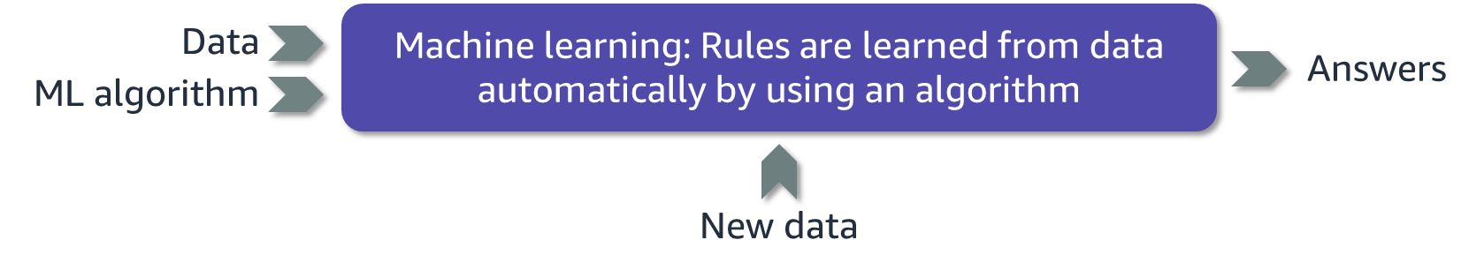
What is ML?
Notes:
~Alt text – image 1: Classical programming flow. Detailed description in notes.
~Alt text – image 2: Machine learning flow. Detailed description in notes.
~
Image 1 description: Flowchart of classical programming. Data and rules go into a box that says, "Classical programming: Rules created manually.” Answers result from the process. End description.
Image 2 description: Flowchart of machine learning. Data and the ML algorithm go into a box that says, “Machine learning: Rules are learned from data automatically by using an algorithm.” New data also goes into the box from below. Answers result from the process. End description.
So, what is ML?
Arthur Samuel, an American computer scientist who worked at IBM and was a pioneer in the field of AI, coined the term in a 1959 journal article. He wrote, “Programming computers to learn from experience should eventually eliminate the need for much of this detailed programming effort.” In the same article, Samuel stated, “a computer can be programmed so that it will learn to play a better game of checkers than can be played by the person who wrote the program.”
In other words, ML is teaching a machine to learn how to do a task through algorithms that can learn from experience without relying on rules-based programming.
That sounds similar to classical programming in that you still need to code something. The key difference is that in classical programming you need to provide an exact recipe (code, sequence of steps, if–else conditions) that tells the machine what rules to apply to solve the problem and provide the answers.
Manually crafting and enhancing rules can be a difficult and cumbersome task. It can even be impossible because you don’t know the rules to begin with, and you often need rare domain expertise or the perspective of a top expert.
Think of writing a program for the complex task of face recognition. With ML, you move the difficult task of crafting rules to a machine. You still need to provide some code (ML algorithm, a set of instructions) and data (ideally with answers), but that code will instruct the machine how to learn or extract rules from the data and answers. The machine-inferred or machine-learned rules are the trained ML model, which can then be used to provide answers to new, similar problems on new, similar data.
Reference:
A. L. Samuel, "Some Studies in Machine Learning Using the Game of Checkers," IBM Journal of Research and Development 3, no. 3. (July 1959): 210-229. https://doi.org/10.1147/rd.33.0210.

Slide 14
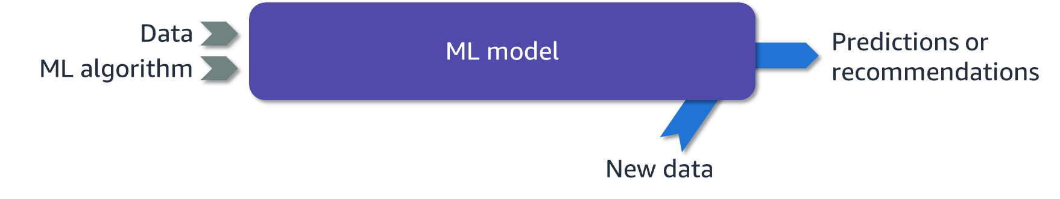
How does the machine learn?
Data: Past information that is relevant to what you want the machine to predict or recommend
ML model: Mathematical model that learns patterns from data by using an algorithm
ML algorithm: Pre-built math equations that show the machine how to understand your data
New data: Entering new data gives you answers
Notes:
~Alt text: The ML flow from the previous slide. However, for the output, answers is replaced with predictions or recommendations.
~
Consider this high-level overview of how a machine learns.
You start with data. That data has been prepared so that it focuses only on past information that is relevant to what you want the machine to predict or recommend. For example, if you want to predict the best price for something, you would include data about all the items that sold and didn’t sell, such as who made the item, where they were located in the store, and what the price was.
You then apply an ML algorithm to the data. You will learn more about ML algorithms in later lessons. For now, understand that the algorithms are prebuilt. They are designed by advanced ML experts to be able to take your data and feed it to the machine so that the machine can make sense of it. The algorithm helps the machine to recognize patterns in the data that are based on the type of data you give to the machine. For example, if you want to predict home prices, you would use an algorithm that is designed to handle that kind of problem. Again, this is a high-level description—it’s not critical that you understand what an algorithm is yet. Right now, you only need to understand that algorithms are the part of this process that helps the machine to understand your data.
The data and ML algorithm together create an ML model. Creating the model is a complicated process that involves a lot of steps, but the result is a model that you can use on future data. In the future, you can give data to the model, and the model will give you answers to a question in the form of a prediction or recommendation.

Slide 15
ML key concepts

Slide 16
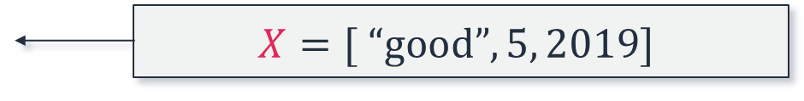
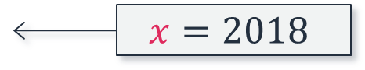
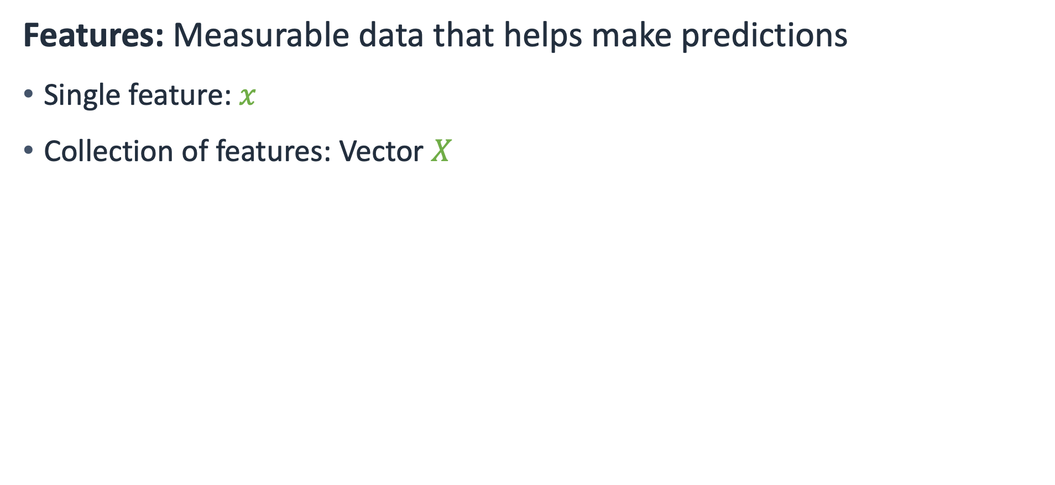
Data: Features
Features: Measurable data that helps make predictions
Single feature: $x$
Collection of features: Vector $X$
Example book feature: Year sold
$$x=2018$$
Example set of book features:
Book condition
Month sold
Year sold
$$X=[ “good”, 5, 2019]$$
Notes:
~Equation text
~
Features are also called data or input.
For a single data sample, features are usually denoted as a variable $x$ for a single feature or as a vector $X$ for a collection of features.

Slide 17
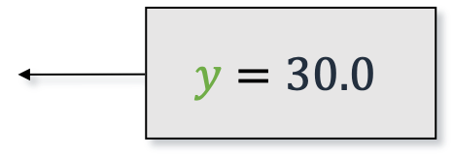
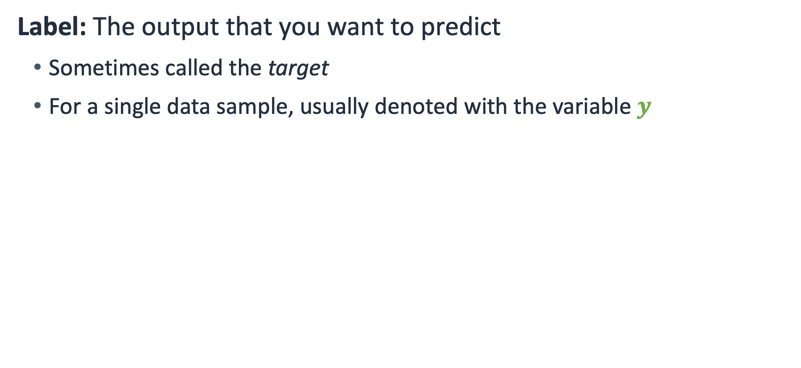
Data: Label
Label: The output that you want to predict
Sometimes called the target
For a single data sample, usually denoted with the variable $y$
$$y=30.0$$
A particular book target: book sale price
Notes:
~Equation text
~
The label is also called the target or output—what you are trying to predict.

Slide 18

Most common types of data that are used in ML
Tabular (in tables)
Image
Text
Month Sold | Year Sold | Genre | Sale Price
7 | 2008 | Romance | 18.10
7 | 2007 | Astronomy | 13.00
7 | 2008 | Biography | 19.99
10 | 2006 | Science Fiction | 25.20
Books have that strange quality, that being of the frailest and tenderest matter, they outlast brass, iron and marble.
– William Drummond, Bibliotheca Edinburgena Lectori
Tabular data will be used for the pricing problem
Notes:
~Alt text: Books on a shelf of library books.
~
In ML, a lot of different types of data can be used. However, three types are used most often: tabular data, which is data stored in tables, such as a spreadsheet or database; images; and text. You will learn more about each type of data throughout the course.
For the book pricing problem, tabular data will be used because it is the most relevant to the problem that you are trying to solve.
Image attribution: Vanmulondo/CC BY-SA 4.0 (https://creativecommons.org/licenses/by-sa/4.0/): https://commons.wikimedia.org/wiki/File:Bookcase_3_at_Busesa_Community_Library,_Busesa,_Bugweri_District.jpg

Slide 19
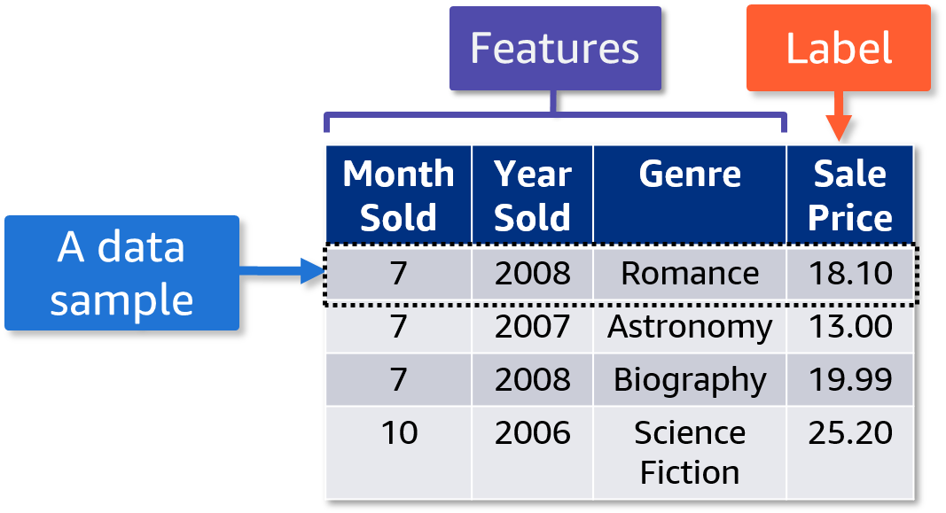
Tabular data: Features and labels
Rows represent each data sample.
Columns represent each feature and the label.
Notes:
~Dev note: Graphic marked as decorative because it is described in the slide notes.
~
When tabular data is used in ML, the rows of the table represent each data sample. The columns represent each feature and the label.
In this table, the features include Month Sold, Year Sold, and Genre, while the label is the Sale Price. Each row is a data sample.

Slide 20
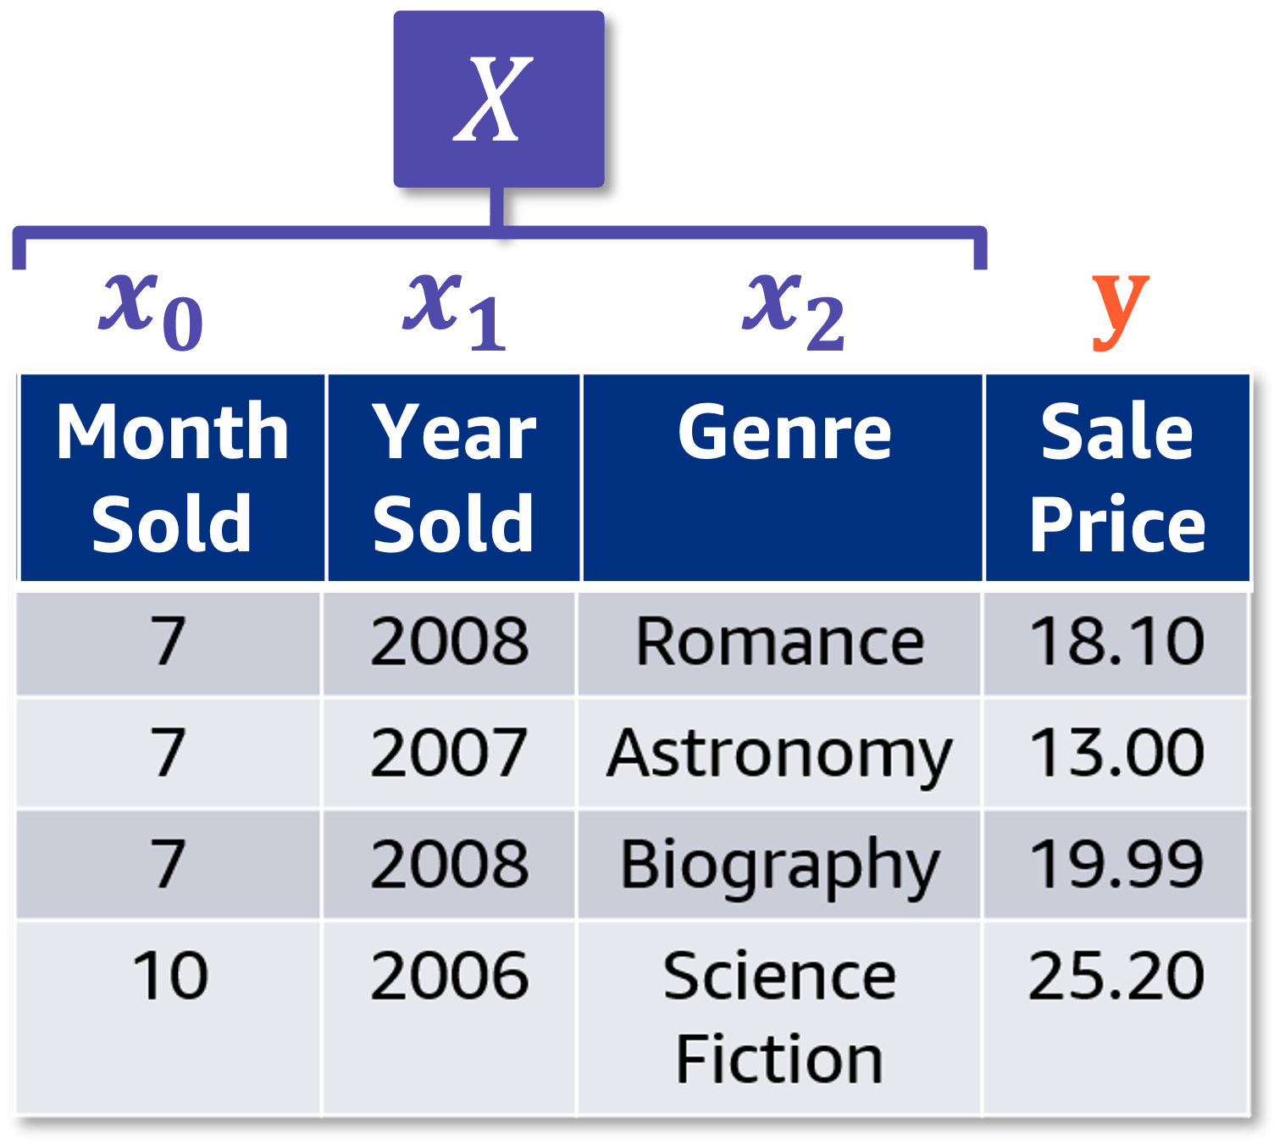
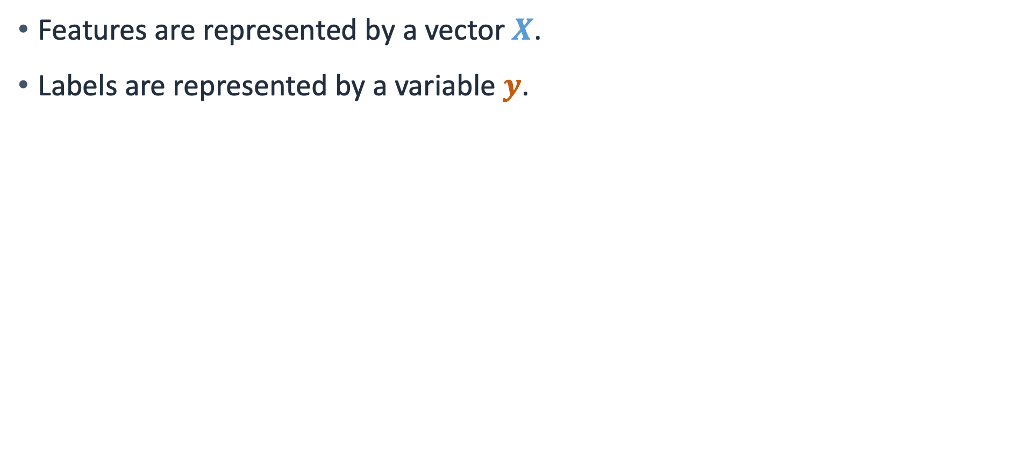
Tabular data: Vectors and variables
Features are represented by a vector $X$.
Labels are represented by a variable $y$.
Notes:
~Equation text
~Alt text: Table from previous slide. First three columns are features, and fourth column is the label. Highlights to show that feature columns are denoted as X and labels are represented as y.

Slide 21
An example of a model that can solve the book price problem

Slide 22
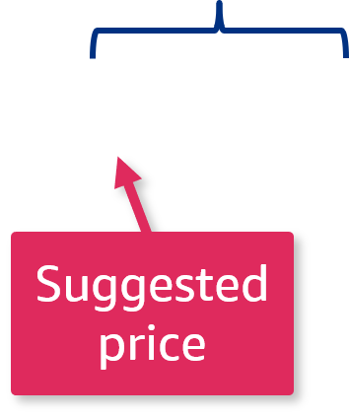
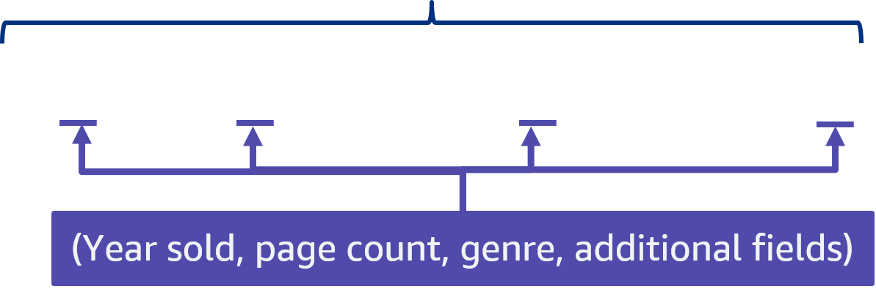
ML model: An example
The goal is to predict a good suggested book price.
prediction ~ weighted combination of features
$$\hat{y} =f\left(x\right)≈a_{0}x_{0}+a_{1}x_{1}+…+{a_{4}x_{4}+…+a}_{n}x_{n}$$
Notes:
~Equation text
~Alt text – left side of equation: Callout on the equation to indicate that y_hat is the prediction, which is the suggested price.
~Alt text – right side of equation: Callout on the equation to indicate that the prediction is approximately equal to the weighted combination of features.
~
Consider the book pricing problem. You will use ML to determine the suggested price for books.

Slide 23
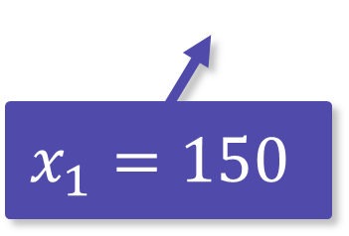
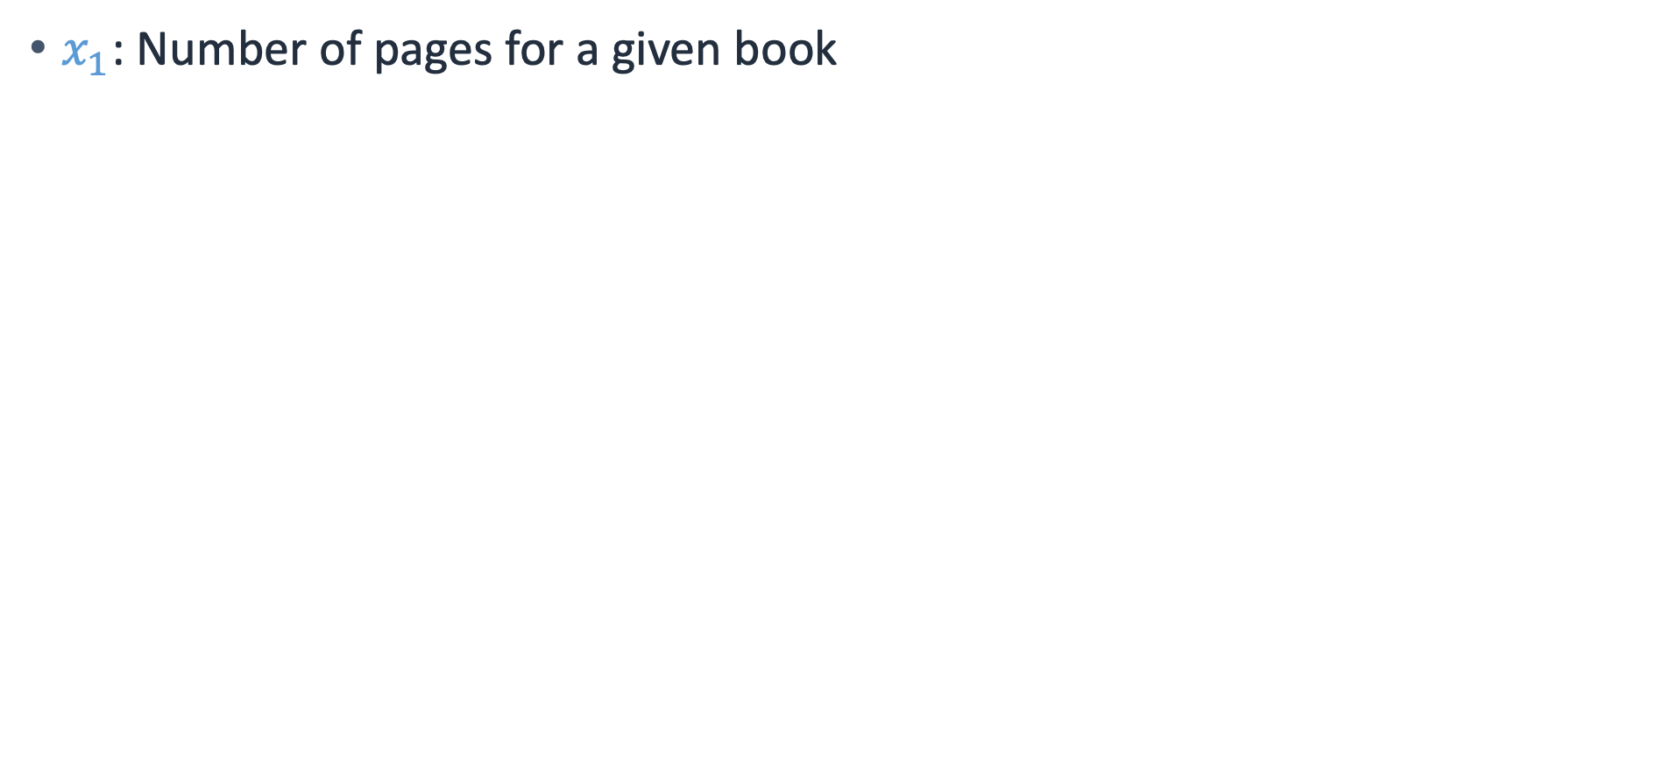
ML model: Feature 1
$x_{1}$: Number of pages for a given book
prediction ~ weighted combination of features
$$\hat{y} =f\left(x\right)≈a_{0}x_{0}+a_{1}∗150+…+{a_{4}x_{4}+…+a}_{n}x_{n}$$
$$x_{1}=150$$
Notes:
~Equation text
~
A feature is a measurable piece of information.

Slide 24
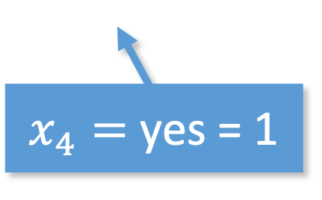
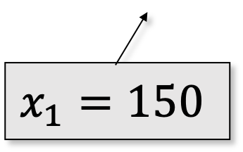
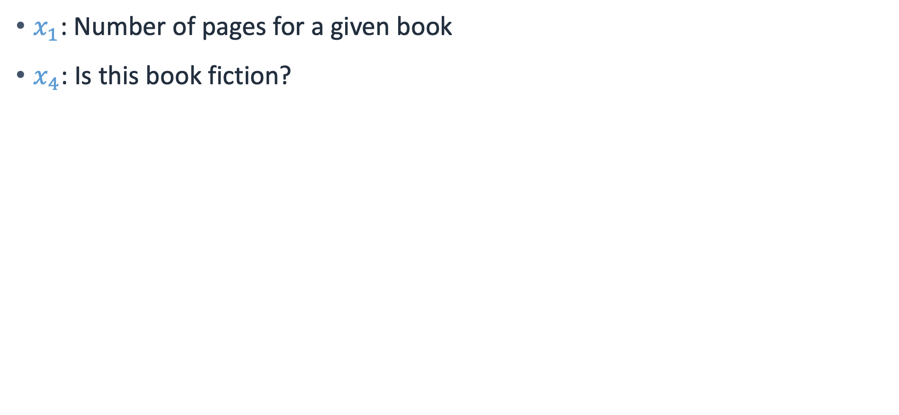
ML model: Feature 4
$x_{1}$: Number of pages for a given book
$x_{4}$: Is this book fiction?
prediction ~ weighted combination of features
$$\hat{y} =f\left(x\right)≈a_{0}x_{0}+a_{1}∗150+…+{a_{4}∗1+…+a}_{n}x_{n}$$
$$x_{1}=150$$
$x_{4}=$ yes = 1
Notes:
~Equation text
~Alt text: Same equation as the previous slide but with the value of 1 for the x_4 variable.
~
A feature is a measurable piece of information.

Slide 25
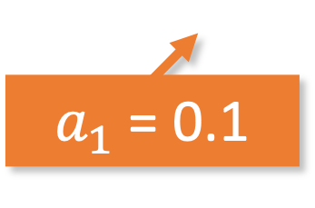
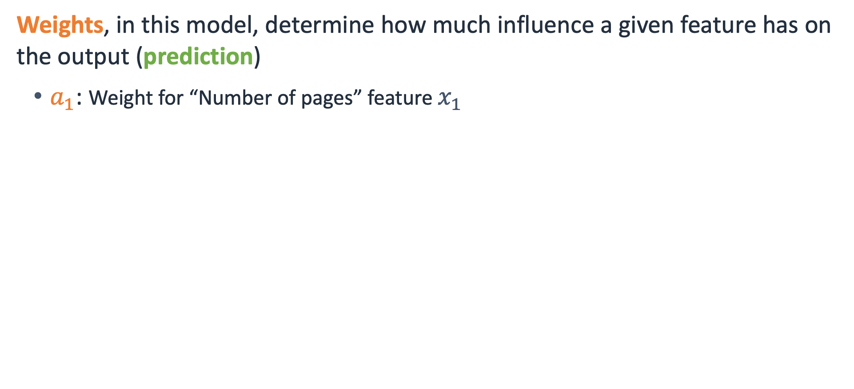
ML model: Weight 1
Weights, in this model, determine how much influence a given feature has on the output (prediction)
$a_{1}$: Weight for “Number of pages” feature $x_{1}$
$$\hat{y} =f\left(x\right)≈a_{0}x_{0}+0.1∗150+…+{a_{4}∗1+…+a}_{n}x_{n}$$
$a_{1}$= 0.1
Notes:
~Equation text
~Dev note: This slide provides the source for the flattened image on the next slide.
~
Weights determine how much influence a given feature has on the output (prediction).

Slide 26
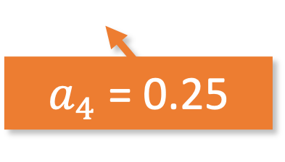
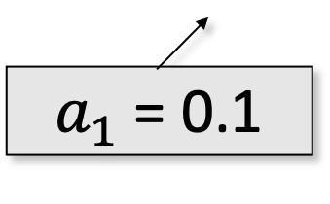
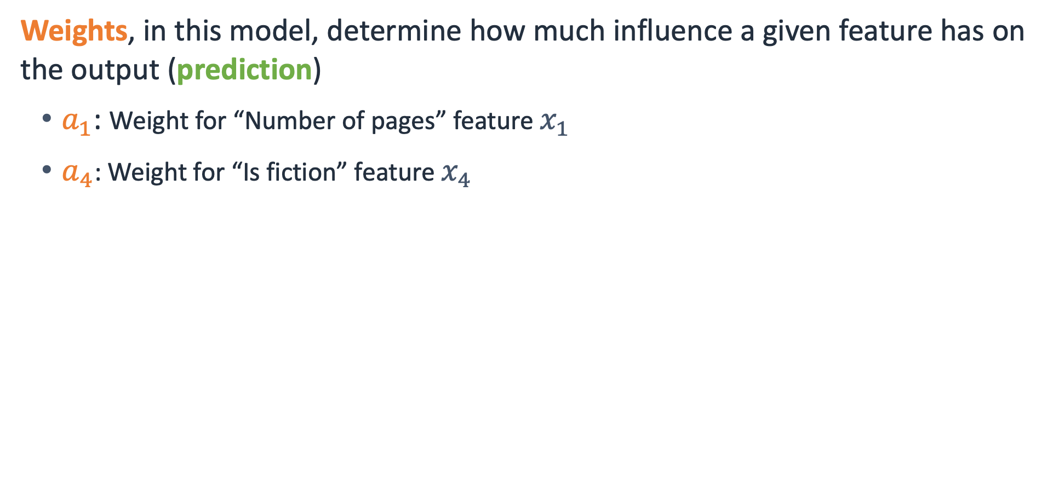
ML model: Weight 4
Weights, in this model, determine how much influence a given feature has on the output (prediction)
$a_{1}$: Weight for “Number of pages” feature $x_{1}$
$a_{4}$: Weight for “Is fiction” feature $x_{4}$
$$\hat{y} =f\left(x\right)≈a_{0}x_{0}+0.1∗150+…+{0.25∗1+…+a}_{n}x_{n}$$
$a_{1}$= 0.1
$a_{4}$= 0.25
Notes:
~Equation text
~Alt text: Same equation as the previous slide but with the value of .25 for the a_4 variable.
~
Weights determine how much influence a given feature has on the output (prediction).
Consider an additional weight:
$a_{4}$: Weight for “Is fiction” feature $x_{4}$
prediction ~ weighted combination of features:
$$\hat{y} =f\left(x\right)≈a_{0}x_{0}+0.1∗x_{1}+…+{0.25∗x_{4}+…+a}_{n}x_{n}$$

Slide 27
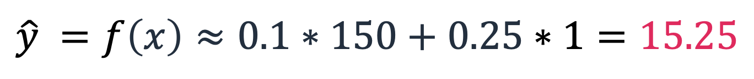
ML model: Prediction
For this model, use these two features to determine a price to suggest.
$$\hat{y} =f\left(x\right)≈0.1∗150+0.25∗1=15.25$$
Suggested price of a 150-page book in the fiction genre is $15.25
Note: This example shows how a model can make predictions; the method to learn these weights from data will be explained later.
Notes:
~Equation text
~
Consider a model that uses these two features, number of pages and whether the book is fiction. Predict the price of a book.
prediction ~ weighted combination of features:
$$\hat{y} =f\left(x\right)≈0.1∗150+0.25∗1=15.25$$
This only shows how an ML model can make predictions after training, but this example doesn’t show how to train the model. To understand how these weights can be learned from data, you will need to learn more about what ML is, where it is used, and how it is measured.

Slide 28

Next lesson
What are Jupyter notebooks, and how do you use them with ML?
What is SageMaker, and how can you use Jupyter notebooks with it?

Slide 30
Image source slides (for curriculum development use only)

Slide 31
Source graphic: What is ML?
Data
Classical programming: Rules created manually
Answers
Rules
Data
Machine learning: Rules are learned from data automatically by using an algorithm
Answers
ML algorithm
New data
Notes:
~Source graphic for slide 11

Slide 32
Source graphic: How does the machine learn?
Data
ML model
Predictions or recommendations
ML algorithm
New data
Notes:
~Source graphic for slide 12

Slide 33
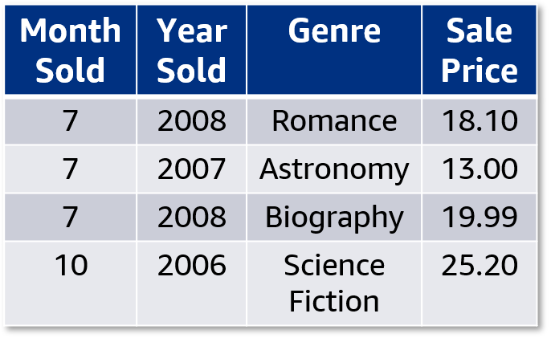
Source graphic: Tabular data: Features and labels
Features
Label
A data sample
Notes:
~Source for slide 17

Slide 34
Source graphic: ML model: An example
prediction ~ weighted combination of features
$$\hat{y} =f\left(x\right)≈a_{0}x_{0}+a_{1}x_{1}+…+{a_{4}x_{4}+…+a}_{n}x_{n}$$
Suggested price
(Year sold, page count, genre, etc.)
Notes:
~Source graphic for slide 20

Slide 35
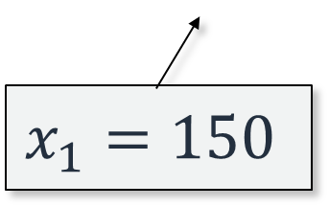
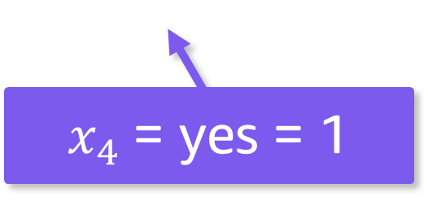
Source graphic: ML model: Feature 4
prediction ~ weighted combination of features
$$\hat{y} =f\left(x\right)≈a_{0}x_{0}+a_{1}∗150+…+{a_{4}∗1+…+a}_{n}x_{n}$$
$$x_{1}=150$$
$x_{4}$= yes = 1
Notes:
~Source graphic for slide 22

